Slide 1



Improving Health Professionals’ Initial Training on Breastfeeding in Québec:
Insights on the Framing of the Issue and Agenda Setting
Sparking Population Health Solutions
Ottawa, Canada
April 27, 2016
Isabelle Michaud-Létourneau, PhD, MPH, RD
Julie Lauzière, Msc, RD
Micheline Beaudry, PhD, RD
Laura Rosa Pascual, MD (Argentine), PhD, IBCLC
Juliette Le Roy, MD (France), IBCLC
Sylvie Chiasson, MA
Jacqueline Wassef, MPH, RD
Isabelle Chartier, Inf BSc, MSc
Myrtha Traoré, BSc
Marion Gayard, MSc, PharmD
Part of this work is funded through the generous contribution of the IRSC and the MSSS

Slide 2


Framework for Action
Shiffman, J. and S. Smiths’ (2007)
What makes some health issues receive the attention of political leaders ?
How do we generate political priority around health issues ?
FOUR CATEGORIES:
  Issues characteristics
  Political context
  Actors
  Ideas
The role of power is central

Slide 3
ISSUES CHARACTERISTICS

Slide 4
Benefits of Breastfeeding are Largely Known
Issues
Acta paediatrica – Supplement - Decembre 2015

Slide 5
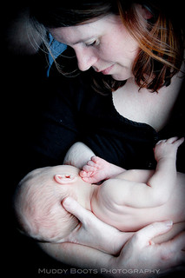
Breastfeeding Promotion
Issues
Breastfeeding promotion has had adverse effects in the absence of proper support
  Physical and psychological suffering
A large number of mothers state that they haven’t reached their own breastfeeding goals
Source: Amy Bundy (via Flicker)

Slide 6
Issues
Total BF & exclusive BF Rate
according to infant’s age
Whereas 85 % of mothers breastfeed at discharge from maternity
(infant is ≈ 2 days old)
Only 50 % exclusively breastfeed !!!
%
Adapted from Neill et al.: Recueil statistique sur l’allaitement maternel au Québec, 2005-2006, Québec, Institut de la statistique du Québec,

Slide 7

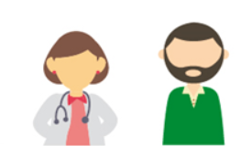
Working Upstream
Issues
Cegeps, universities
Health professionals

Slide 8
Survey: Basic Curriculum and Training of Health Professionals in Québec
Issues
Dentists, nurses, medical doctors, registered dietitians, pharmacists, midwives

Slide 9
Main conclusions of the 2011-2012 survey
Issues
In many programs...
  Marked gaps in content
  Heterogeneity in training
  Far from the recommandations of
    World Health Organization,
    American Academy of Pediatrics
    Academy of Breastfeeding Medicine
Programs have similar needs
Confirmed interest of respondees with the issue
  Urgent needs to address the gaps in training of health professionals on breastfeeding because it may take 5-10 years before changes are in place

Slide 10
POLITICAL CONTEXT

Slide 11

Political Context
Political Context
1991: Baby Friendly Hospital Initiative (BFHI) - WHO & UNICEF
      Ten steps to successful breastfeeding
      Minimum of 20 hours of basic training in breastfeeding
1998 : Launch of the Baby-Friendly Initiative (BFI) in Canada
2008 : Québec Ministry of Health and Social Services:
Initiative Amis des Bébés (IAB)
2009: Creation of MAQ (Quebec Breastfeeding Movement)
Committee on training

Slide 12
ACTORS

Slide 13

Who Are We?
ACTORS
Created on April 9, 2009
Mission
Promote enabling environment for breastfeeding
  Optimal development of young children and well-being of women, families and society
  Respect of all women and all families
Independent consultation forum

Slide 14
MAQ Committee on Training
ACTORS
Created in November 2010
Mandate
Ensure harmonization of minimum competencies in breastfeeding of all health professionals in the province
through the basic content of their academic curriculum and training

Slide 15

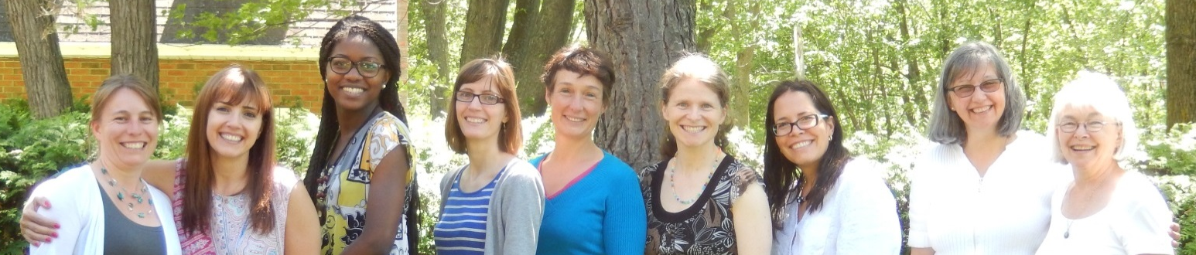
Committee Structure
ACTORS
Members’ affiliation and expertise:
  Academic, health professionals, community
  Biology, communication, lactation consultant (IBCLC), medicine, nutrition, pharmacy, nursing, osteopathy
  Québec, Sherbrooke, Trois-Rivières, Montréal; international
Sylvie
Julie, Jacqueline, Myrtha, Marion, Juliette, Isabelle ML, Isabelle C, Laura, Micheline

Slide 16

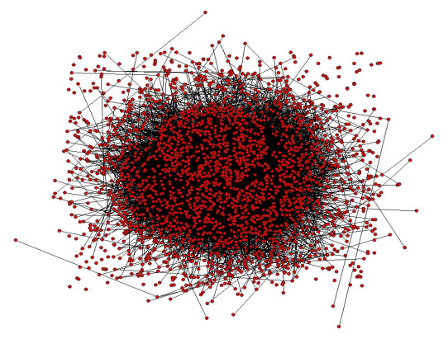
Actors
ACTORS
Actors involved in the curricula and trainings of the six health professions in Québec cegep and universities (dentists, dietitians, medical doctors, pharmacists, nurses, midwives ) :
  Program professors
  Program administrators and managers
  Students
Professional Orders of the six health professions
Québec Ministry of Health and Social Services
Québec Ministry of Education
National Institute of Public Health
Partners from academic institutions of other provinces
MAQ Partner organisms
In addition to MAQ & MAQ Committee on training
Actually the MAQ has gathered more than 115 professors and program administrators across Québec who showed interest and engagement

Slide 17

IDEAS
FRAMING
Collective Impact Initiative
Responsibility of all health professionals

Slide 18


Launch of a Change Process
IDEAS
The statuts quo is not an option
Network and promote interprofessional collaboration of 7 health professions

Slide 19

Workshop - APRIL 29 2016
STRATEGIC PLANNING WORKSHOP FOR THE HEALTH PROFESSIONALS’ INITIAL TRAINING ON BF
Part of this work is funded through the generous contribution of the IRSC and the MSSS

Slide 20
Participants (60) at the Workshop
Regions
Professions
Organisations
Capitale-Nationale
Estrie
Laval
Mauricie
Montérégie
Montréal
Outaouais
+ Ottawa (Ontario)
+ Moncton (NB)
Chiropractors
Lactation Consultants
Dentists
Nurses
Medical doctors
Nutritionists
Pharmacists
Midwives
Colleges (Cégeps)
Universities (Québec and 2 other provinces)
Professional Orders
Others: Health services network and clinical settings
Assistant deans, program directors
Professors, teachers, lecturers, practicum coordinators
Students
Delegates of professional Orders and other establishments
Practicing professionals – others
Functions

Slide 21
Facilitators and Barriers to Agenda Setting
Facilitators
Barriers
Strong established partnerships with various actors
Ongoing and planned research projects
Successful education transformation model previously applied to the clinical practice with the elderly
Workshop on April 29, 2016
Funding to support the strategic group and link the various provinces together
Keep interest of stakeholders high
Need to engaged high-level actors

Slide 22
Ideas
Stages of research/actions leading to the Collective Impact Initiative
Enhanced BF competencies in health centers and hospitals
Enhanced BF knowledge, attitudes and practices in initial training
Curricula changes in 3 provinces
RESULTS
Stage 4: Carrying out a Collective Impact initiative to improve BF curricula in the initial training of health professionals from 6 professions in 3 provinces
Strategic planning workshop (Qc)
Identify barriers and enablers to curricula changes
Agree on minimal BF objectives
Develop a targeted BF curriculum for pediatric residents
Stage 3: Reaching consensus on a common agenda, transversal BF objectives, and shared indicators
and measurements
Stage 2: Setting the stage and engaging key players in universities, colleges and professional associations
Planning a national BF educational intervention for medical students
Get funding for a strategic workshop in Qc
Identification of:
BF trainings gaps in 6 health professions in Qc
Potential deficits in BF knowledge & attitude of Canadian physicians
Stage 1: Assessing BF training and consulting stakeholders
PROCESSES
2010-11
2013-15
2015-16
2016…
2020
Creation of core group of strategic players
Surveys of pediatricians in Canada
Surveys of 6 health professions in Qc
Newsletters (6) to engage with key audience (professors)
Proposal writing to get funding for workshop
Increased communication between MAQ and researchers
Creation of this project
Focus groups to engage players
Delphi survey to consult and engage experts
Strategic workshop (launch) in Qc to reach consensus
Launch in 2 provinces
Working groups in 3 provinces, develop strategies (e.g. by institutions, professions, issues)
Broker knowledge to monitor actions and create synergy
Create a global forum of exchange between players
Monitor progress in policy processes
Develop doctoral projects

Slide 23
THANK YOU

